Slide 1


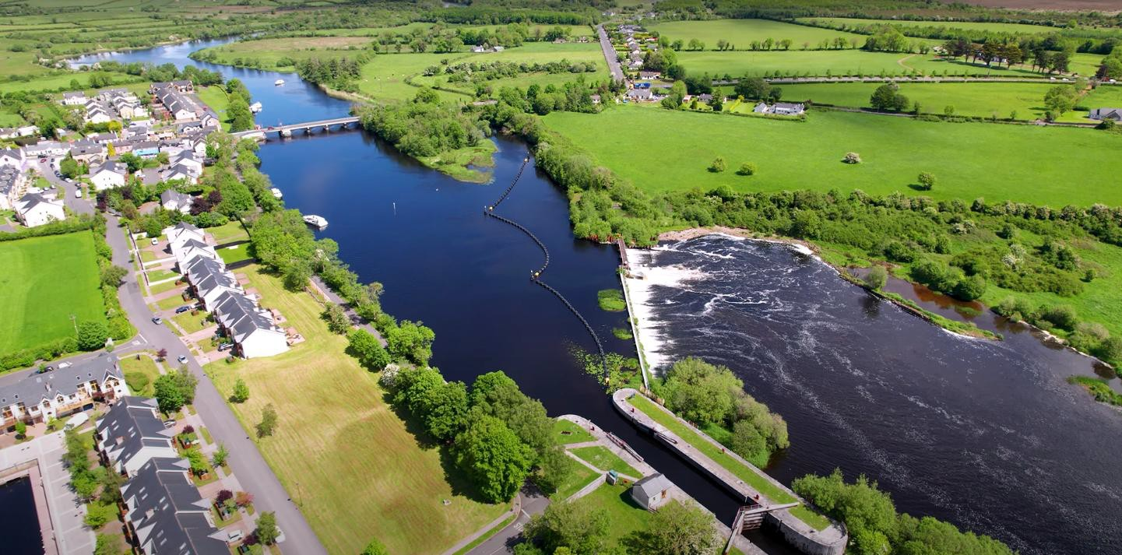


Clondra to Tarmonbarry Greenway
Open Day
Tuesday 28th July 2026

Slide 2
Project Objectives
Provide a vital link between the planned Greenways on the Roscommon side of the River Shannon, and the current termination point of the Royal Canal Greenway at Richmond Harbour, Clondra
Provide for the economic growth of west County Longford bordering the River Shannon
Provide a safe off-road cycling and walking amenity for the residents of Clondra and Tarmonbarry

Slide 3
Timeline
Preliminary Business Case being prepared under the EU Just Transition Fund, to be completed in August 2026
Preliminary Business Case assesses route options, and will recommend an Emerging Preferred Option
The timing of future phases of the project is dependent on:
  Availability of funding
  Liaison with Waterways Ireland on the use of Tarmonbarry Weir

Slide 4
Main Route Considerations
Off-road to the greatest possible extent, for user safety
Usable for the majority of the year (i.e. avoid flood risk zones)
Affordable
Minimise impact on existing land uses
Minimise impact on existing residents

Slide 5
Greenway Design
Lands are to be acquired (not permissive access). This is TII requirement for Greenways
Surface is to be sealed (i.e. tarmac)
Greenway is to be designed to:
  National Cycle Manual, and TII Rural Cycleway Design (Offline & Greenway)
    Approx. 3.5m corridor
    Desirable max. gradient 3%

Slide 6

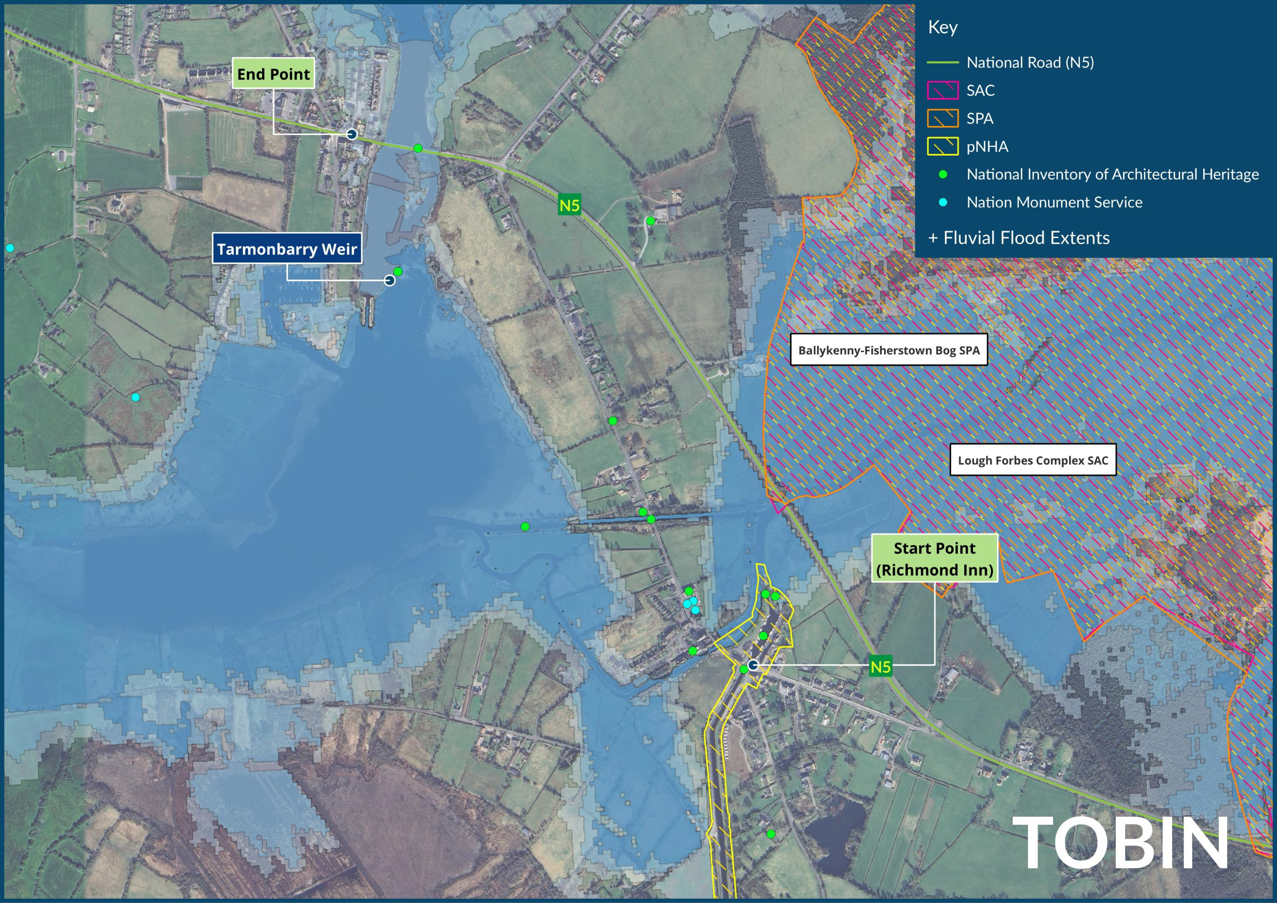
Constraints

Slide 7
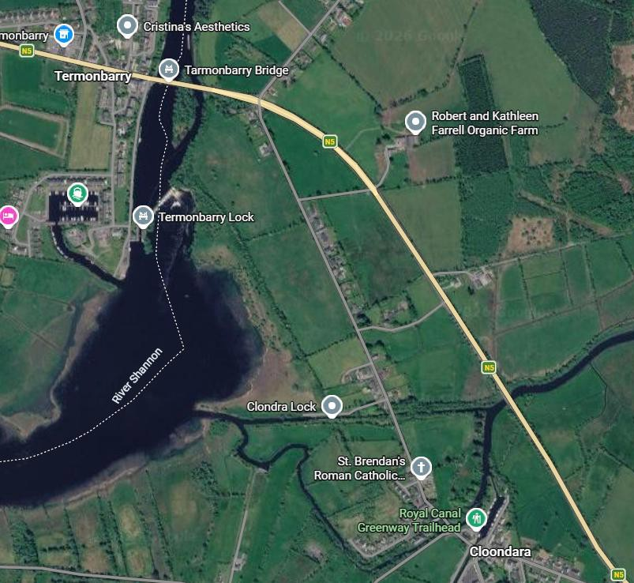
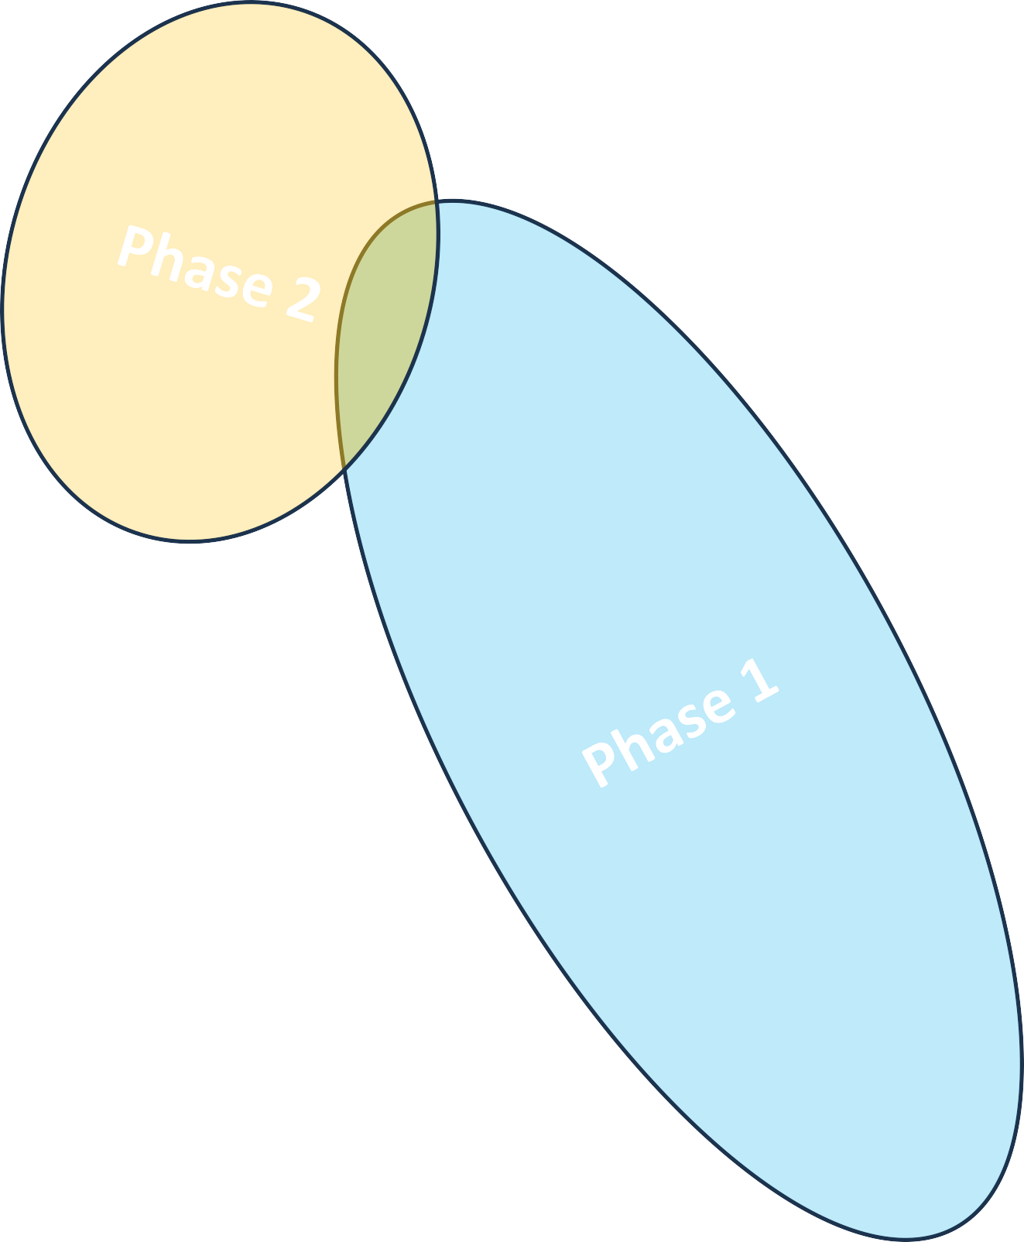
Route Phasing
Phase 1: Clondra to the eastern bank of the River Shannon
Phase 2: Crossing the River Shannon

Slide 8
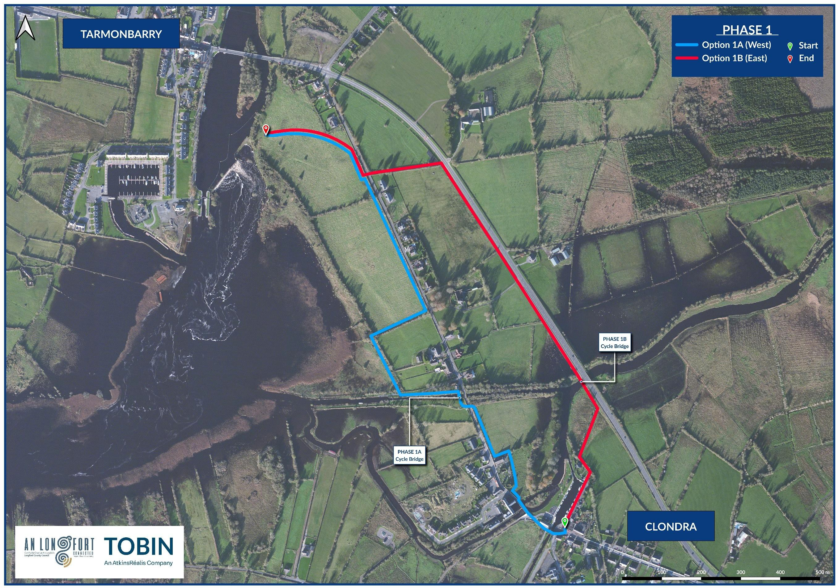
Phase 1: Clondra to the eastern bank of the River Shannon
Option 1A: Western Option
Option 1B: Eastern Option

Slide 9
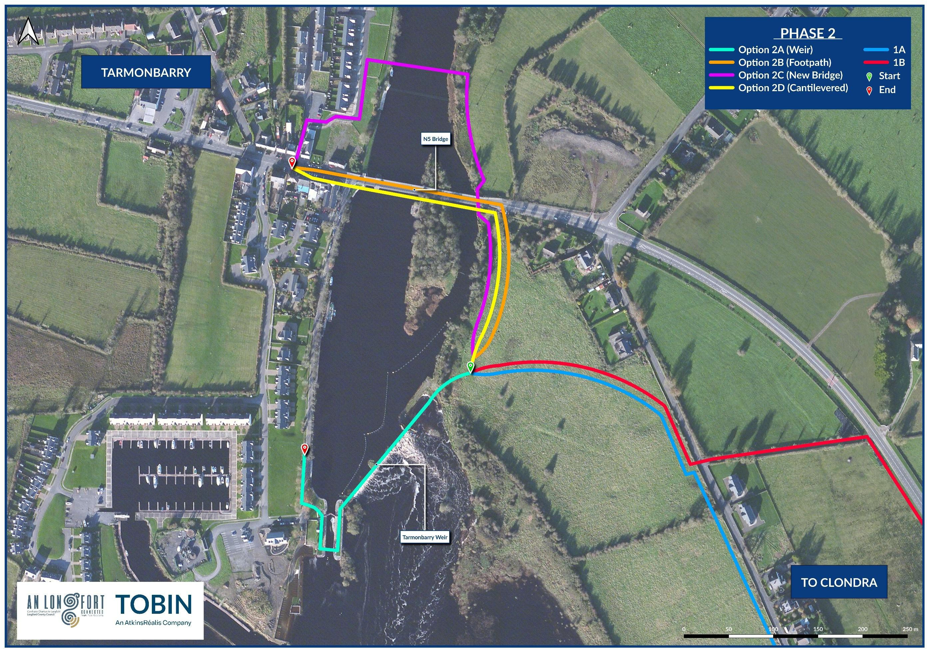
Phase 2: Crossing the River Shannon
Option 2A:
Use Tarmonbarry Weir
Option 2B:
On footpath of N5
Option 2C:
New Cycleway Bridge
Option 2D: Cantilevered Bridge

Slide 10
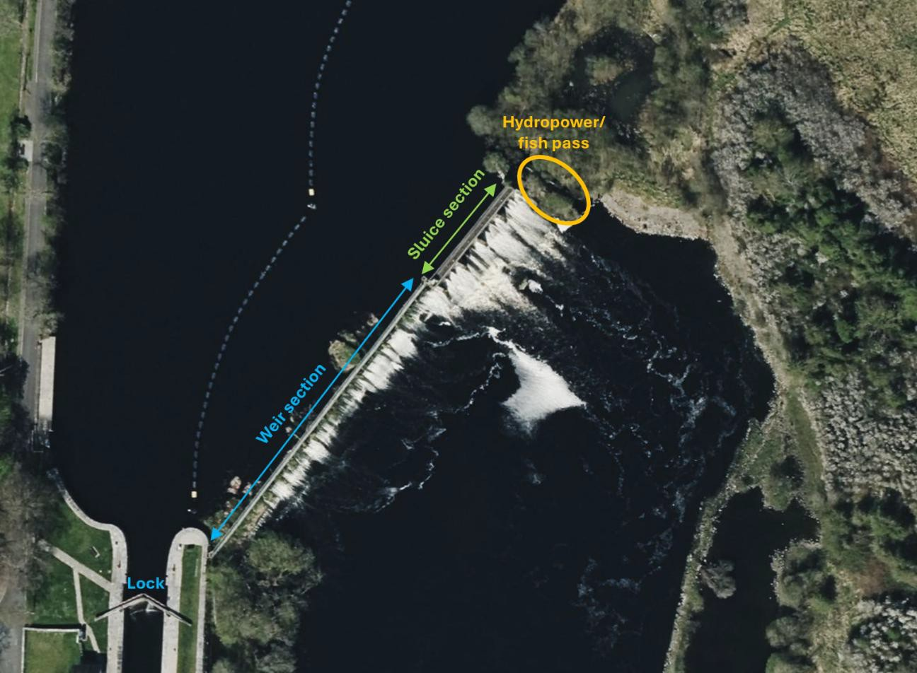
Phase 2: Crossing the River Shannon

Slide 11
Clondra to Tarmonbarry Greenway Cycleway Scheme is co-funded by the Government of Ireland
and the European Union through the EU Just Transition Fund

